Slide 1
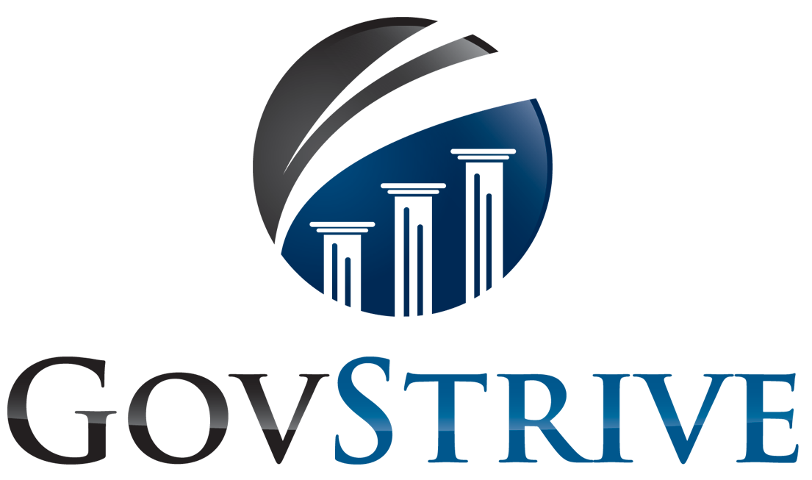
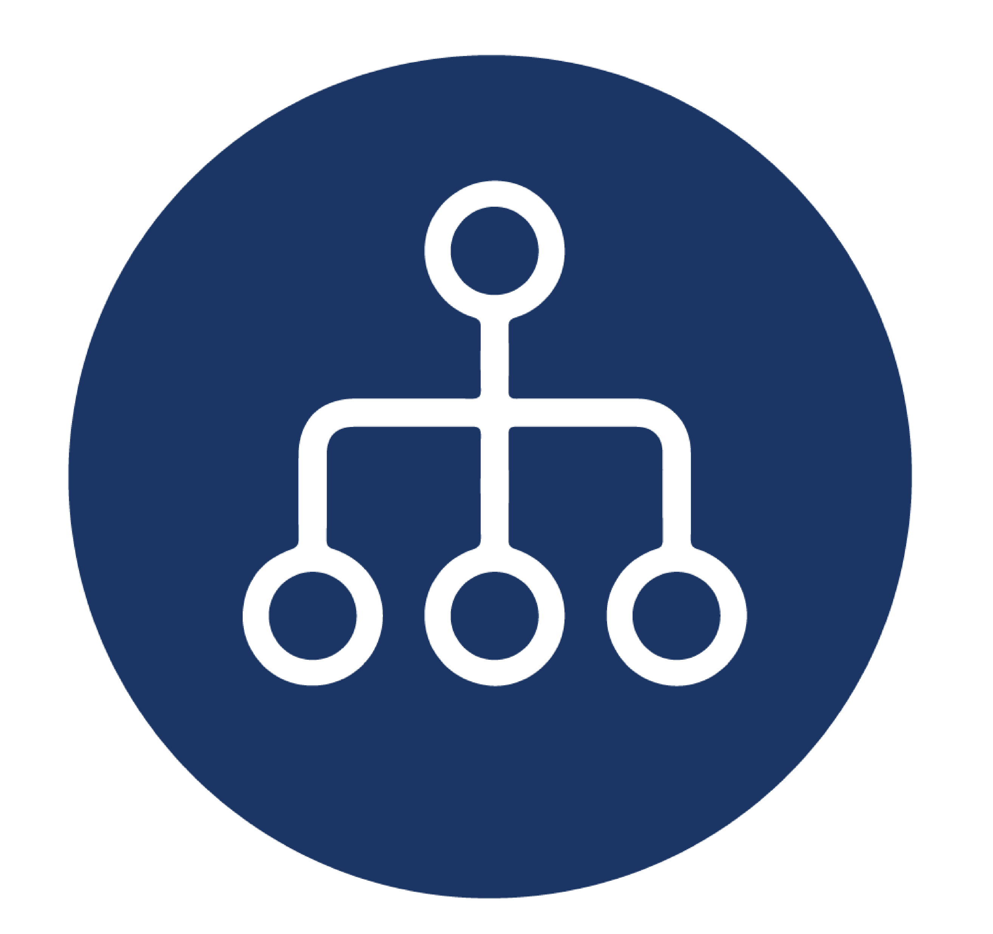
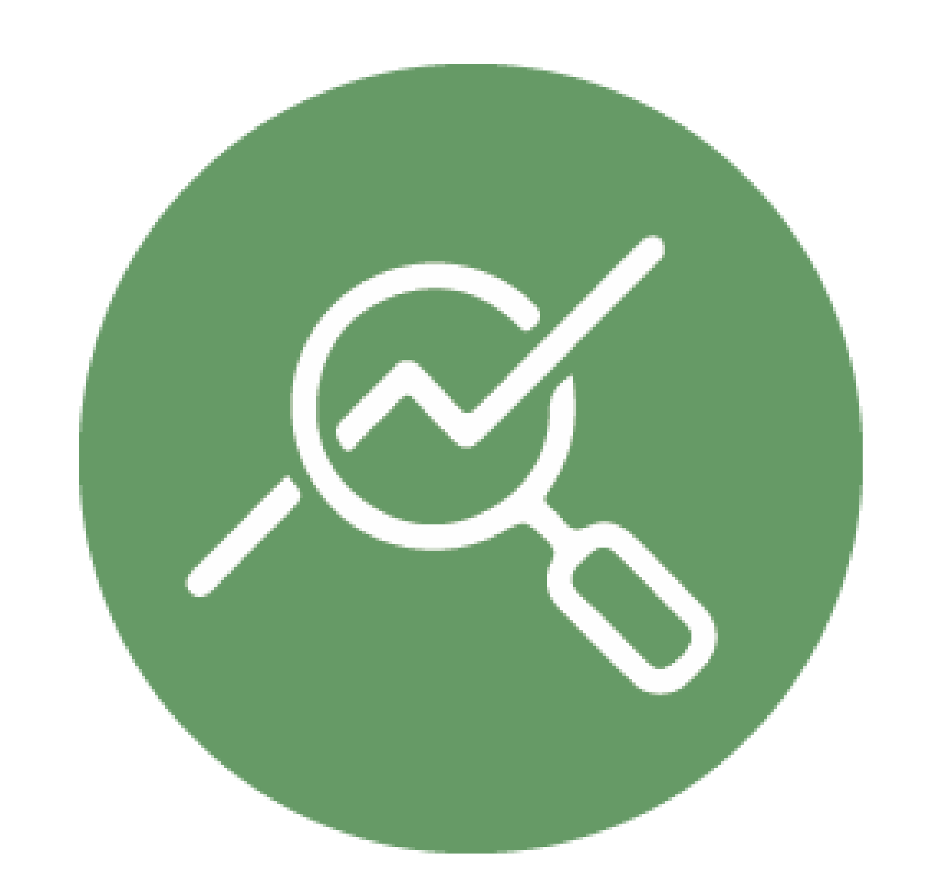
Improving Organizational Health and Performance
How GovStrive's capabilities and applications can help agencies meet objectives in OMB M-23-15
GovStrive understands HR leaders are interested in measuring, monitoring, and making improvements to agency organizational health and performance in response to OMB Directive M-23-15. Through our subject matter expertise and suite of human capital management solutions, GovStrive is positioned to assist agency leaders in analyzing key metrics on retention and recruitment, employee perceptions of their work environments and work units, and how day-to-day work aligns to agency strategic vision, mission, goals. Leveraging these data-driven insights will be crucial as agencies seek to develop organizational health and performance indicators that will shape their future work environments.
GovStrive provides HR leaders with insights and solutions needed to achieve agency mission and strategic alignment.
Our Workforce Analytics and Technology Solutions (WATS) team has extensive experience supporting HR leaders across human capital functions and activities, such as human capital planning development, workforce planning, action planning, and data management and application.
In addition, WATS has developed a human capital ecosystem comprised of three proprietary Software-as-a-Service (SaaS) solutions that empower HR leaders to make strategic decisions to support agency mission and achieve organizational objectives. Our FedSuite applications are FedViews, FedChart, and FedLens.
FedViews
Combine FEVS survey results with HR data to gain insight into employee perceptions of their work, leadership, and environment, and create action plans that target opportunities for improvement.
FedChart
Evaluate your workforce capacity to meet customer needs by automating your organizational charts to better understand how your organization is structured to accomplish mission, functions, and tasks.
FedLens
Analyze your agency data to view key workforce metrics and workforce trends to take a targeted approach with attracting and maintaining top talent through predictive workforce planning models.
Our subject matter experts paired with our suite of cloud-based, SaaS solutions can provide agencies with the resources and guidance needed to assess the current state of organizational health and create measurable targets to address opportunities for improvement, posturing federal agencies to meet requirements of OMB M-23-15.
govstrive.com | fedchart.com | (478) 304-3080

Slide 2
Improving Organizational Health and Performance
How GovStrive's capabilities and applications can help agencies meet objectives in OMB M-23-15
FedViews
FedViews automates analysis of the Federal Employee Viewpoint Survey (FEVS) along with workforce data to provide key insights to agency leaders, saving resources normally spent on manually producing FEVS analyses. FedViews groups survey responses into topics of interest, including Diversity, Equity, Inclusion, and Accessibility (DEIA) metrics. Other FEVS materials that can be used to evaluate organizational health include:
Performance Confidence Index – Measures employee perception of organizational performance.
Employee Engagement Index –Three subindices, Leaders Lead, Supervisors, and Intrinsic Work Experience, measure employee sentiments of their leadership and the nature of their work.
Resilience, Innovation, Responsiveness and Involvement – These survey items measure how individual employees can meet challenges and adapt, if they are comfortable supporting and developing new ideas or approaches, if they are equipped to respond to customer needs, and how they perceive their input is valued.
HR Leaders can utilize FedViews Action Tracker and create action plans derived from these insights to measure and monitor progress toward desired outcomes.
FedChart
FedChart rapidly generates organizational charts from division level to individual work units, enabling HR leaders to quickly view and interact with their organizational structures for scenario-based planning.
HR leaders can use FedChart to identify where key vacancies exist that must be filled to support mission-critical operations. FedChart includes reporting capabilities such that the costs associated with filling these vacancies and their financial impact can be determined quickly. These insights can be leveraged as agency leaders develop organizational capacity plans and workforce requirements models.
Organizational charts - Use agency workforce data to visualize the current organizational structure including organizational levels, offices, encumbered and vacant positions, and employees.
Plan for Reorganizations - Improve collaboration between HR and agency leadership to support activities related to workforce restructuring, position realignment, and scenario-based planning.
Manage Budget & Finance - Track the cost of your workforce compared to the funded ceiling, including cost of encumbered positions and determining the financial impact of filling vacancies, through workforce requirement costing and budgeting.
govstrive.com | fedchart.com | (478) 304-3080

Slide 3
Improving Organizational Health and Performance
How GovStrive's capabilities and applications can help agencies meet objectives in OMB M-23-15
FedLens
FedLens is a research-based HR reporting tool that uses agency data from authoritative systems of record to produce visualizations that can be utilized to inform agency planning and decision-making. Reports available within FedLens include:
Retention Analysis:
Reports on retention trends by length of service, education, occupation, and DEIA variables using workforce data.
This data is then leveraged to determine how opportunities for promotions, awards, career advancement and quality step increases (QSI) can be strategically used to improve retention.
Talent Pool Analysis:
Agency workforce data is compared against DEIA benchmarks to outline skill gaps in the onboard workforce.
In addition, FedLens can help HR leaders identify and recruit potential employees from diverse backgrounds by identifying pools of individuals with the required skills or backgrounds across the country.
Workforce Snapshots:
Provides details on the onboard workforce for key populations of interest.
Key metrics and visualizations reported in snapshots include retirement eligibility, veteran status, RNO/ERI categories, and disability status.
Predictive Analytics:
Trends in workforce gains and losses are analyzed using our proprietary models developed through a research-driven approach, allowing HR leaders to view seasonality in changes to their workforce.
Results from these analyses can be used to forecast future separations or hiring needs.
By compiling workforce data, retention reports, talent pool analysis, and other specific snapshots for workforce insights, FedLens measures and reports many indicators to inform agencies of their organizational health and performance. The insights provided within FedLens will help HR leaders make informed, data-driven decisions to meet their departmental and agency goals.
As the federal workforce returns to the office, fostering an agency work environment focused on organizational health and performance is vital to attract top talent, bolster employee engagement, and retain a high-performing workforce. GovStrive has the capabilities and resources HR leaders need to meet these objectives, ensuring your agency is an employer of choice. Request a demo of any of our FedSuite applications today.
govstrive.com | fedchart.com | (478) 304-3080

